Slide 1
Welcome to the diwali sales analysis-project
Project By-Chetan

Slide 2
Summary of Diwali Sales Data for PPT Presentation
Summary of Diwali Sales Data
1. Overview of the Dataset
Total Entries: 11,251 transactions
Columns (Key Attributes):
  Customer Information: User_ID, Cust_name, Gender, Age Group, Marital Status, State, Zone, Occupation
  Product Details: Product_ID, Product_Category
  Sales Metrics: Orders, Amount
Missing Data: Some values in "Amount" are missing, and "Status" & "unnamed1" columns have no data.

Slide 3
Summary of Diwali Sales Data for PPT Presentation
2. Key Insights for Presentation
Demographics Analysis:
  Majority of buyers are from specific age groups (e.g., 26-35).
  Gender-wise distribution can highlight shopping trends.
  Occupation-based sales trends (e.g., which professions shop more).
Geographical Sales Trends:
  Sales across different states and zones (Central, Western, Southern, etc.).
  Identifying high-revenue states for targeted marketing.
Product & Revenue Analysis:
  Which product categories are the best-sellers?
  Contribution of different products to overall revenue.
  High-value vs. low-value transactions.
Order & Spending Patterns:
  Average amount spent per order.
  Customers placing multiple orders vs. single-time buyers.

Slide 4
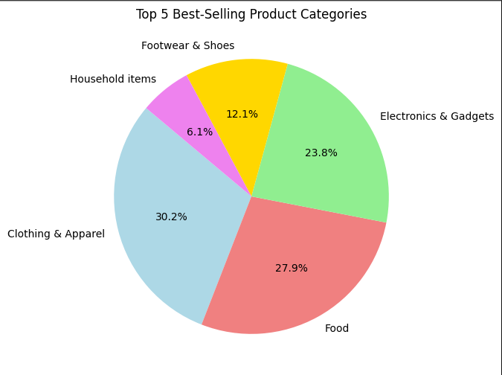
1️⃣ Find Top 5 Best-Selling Product Categories
🔹 Conclusion
--->1. The top 5 product categories with the highest number of orders will be displayed.
--->2. These categories represent the most popular products among customers.
Businesses should focus on stocking more of these items, offering discounts, and creating marketing campaigns to drive more sales.

Slide 5
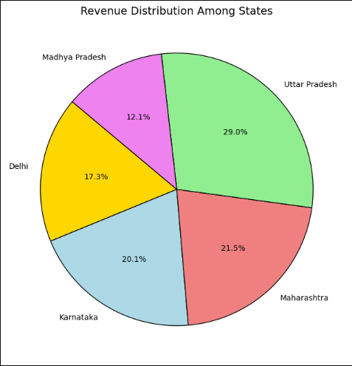
2️⃣ Identify High Revenue-Generating States
📌 Conclusion
1️⃣ Uttar Pradesh (29.0%) contributes the highest sales, indicating it is the most profitable state for the business.
2️⃣ Maharashtra (21.5%) is the second-largest contributor, suggesting strong customer engagement.
3️⃣ Karnataka (20.1%) also has significant sales, making it another key market.
4️⃣ Delhi (17.3%) shows a moderate share, highlighting potential for growth.
5️⃣ Madhya Pradesh (12.1%) has the lowest contribution, suggesting a need for improved marketing strategies in this region.
📝 Business Insights:
✔ Increase marketing efforts in Delhi & Madhya Pradesh to boost sales.
✔ Expand inventory & offers in Uttar Pradesh & Maharashtra to maximize revenue.
✔ Analyze customer preferences in Karnataka to maintain and improve sales.

Slide 6
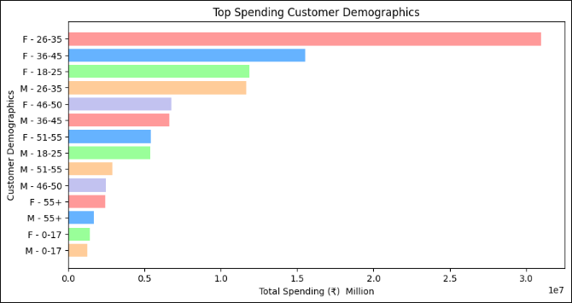
3️⃣ Find Customer Demographics Spending the Most
📌 Conclusion
1️⃣ Females aged 26-35 spend the most, making them the most valuable customer segment.
2️⃣ Females in the 36-45 and 18-25 age groups also contribute significantly to total spending.
3️⃣ Males aged 26-35 are the top male spenders but contribute less than the leading female groups.
4️⃣ Older demographics (46+ years) have lower spending, indicating lower engagement or purchasing power.
5️⃣ Teenagers (0-17 years) have the least spending, likely due to financial dependence.
📝 Business Insights:
✔ Target marketing campaigns towards females aged 26-35, as they are the biggest spenders.
✔ Offer premium and exclusive deals for females aged 18-45 to maintain and boost sales.
✔ Develop strategies to increase engagement among male shoppers, particularly those aged 36-45.
✔ Explore products and promotions tailored for older demographics to increase their spending potential.

Slide 7
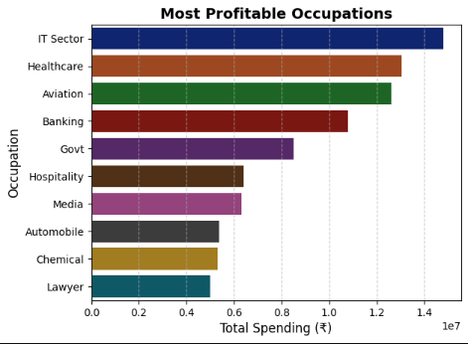
4️⃣ Most Profitable Occupations
📌 Conclusion from the "Most Profitable Occupations" Chart
IT Sector is the Highest Contributor – Customers from the IT sector have the highest total spending, making it the most profitable occupation.
Healthcare & Aviation Follow Closely – These sectors also contribute significantly to overall revenue, indicating strong purchasing power.
Banking & Government Professionals Spend More – This suggests that financial and government professionals are valuable target customers.
Lawyers & Chemical Industry Have Lower Spending – These occupations contribute the least, indicating either lower purchasing power or less engagement in the market.
Marketing Strategy Implications – Businesses should focus on IT, Healthcare, and Aviation professionals by offering premium products, targeted discounts, and personalized promotions to maximize sales.

Slide 8
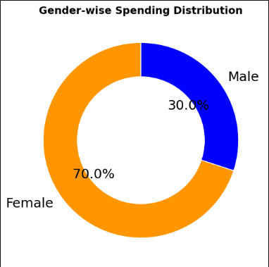
5️⃣ Gender-Wise Purchasing Behavior
📌 Conclusion:
From the Gender-wise Spending Distribution donut chart:
a) Females contribute 70% of the total spending, indicating that they are the primary consumers in this dataset.
b) Males contribute 30%, showing significantly lower spending compared to females.
🔹 Insights & Business Recommendations:
Target Female Consumers: Since females are the major spenders, businesses should focus on marketing strategies, promotions, and personalized offers to attract and retain female customers.
Increase Male Engagement: Introduce male-focused products, discounts, and advertising campaigns to boost male customer spending.
Optimize Product Categories: Analyzing the specific product categories that females prefer can help in inventory management and sales optimization.
This insight can help businesses align their strategies to maximize revenue and customer satisfaction. 🚀📈

Slide 9
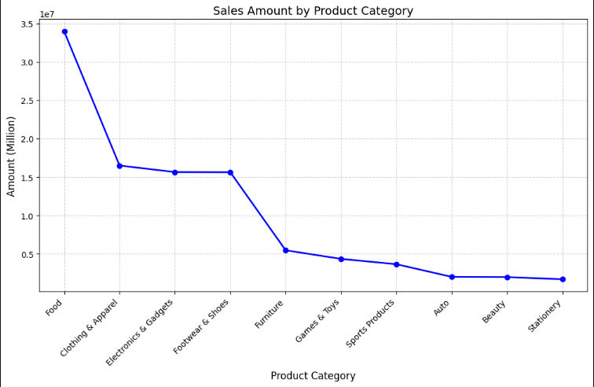
6️ Most Profitable Product Categories
Conclusion
Food has the highest sales amount, significantly leading other product categories.
Clothing & Apparel, Electronics & Gadgets, and Footwear & Shoes follow closely with similar sales figures, indicating strong demand in these sectors.
Furniture and Games & Toys show a moderate level of sales, lower than the top categories but still contributing substantially.
Sports Products, Auto, Beauty, and Stationery have the lowest sales, suggesting either lower demand or market penetration challenges.
The overall trend shows a sharp decline from Food to Furniture, then a gradual decrease towards Stationery.
This suggests that businesses focusing on Food and Apparel may see higher returns, while lower-selling categories might need better marketing or product positioning.\

Slide 10
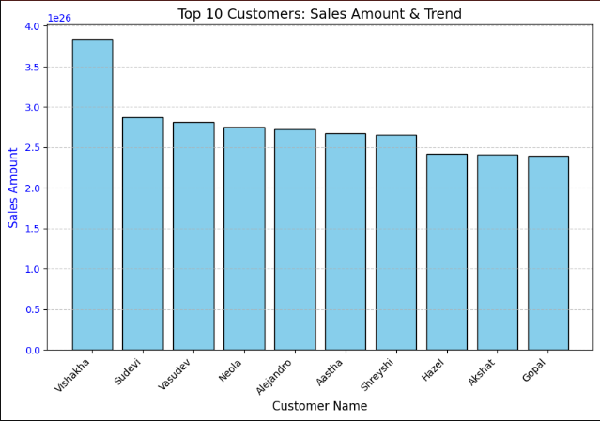
7️. Customer Spending Behavior (High-Value Customers)
📌 Conclusion
1. Vishakha is the Highest Contributor – She has the highest sales amount, significantly more than other customers.
2. Consistent Sales Among Other Customers – The remaining top customers (Sudevi, Vasudev, Neola, Alejandro, etc.) have similar sales figures, with minor variations.
3. Sales Drop After Top 3 Customers – A noticeable decline in sales is observed after Vishakha, with Sudevi and Vasudev having the next highest amounts.
4. Balanced Distribution – Except for Vishakha, most customers have comparable sales values, indicating a more evenly spread revenue contribution.
5. Need for Customer Retention – Businesses may focus on retaining high-value customers like Vishakha while boosting engagement for those with lower sales.

Slide 11
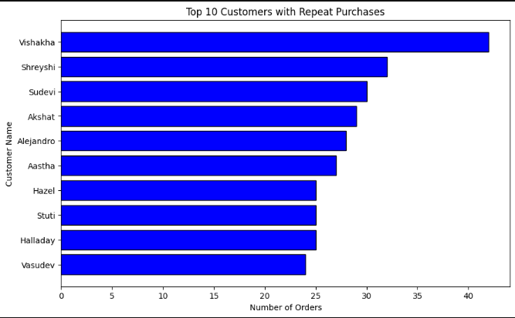
8️⃣ Customer Retention & Repeat Orders
Conclusion: Top 10 Customers with Repeat Purchases
1️⃣ Vishakha is the most loyal customer, making the highest number of repeat purchases.
2️⃣ Shreyshi and Sudevi follow closely, indicating strong engagement with the business.
3️⃣ The top 5 customers contribute significantly to overall sales, suggesting they should be prioritized for loyalty programs.
4️⃣ Businesses can offer personalized discounts, exclusive offers, or early access to new products for these customers to retain their engagement.
5️⃣ Understanding the buying patterns of these top customers can help in targeted marketing strategies and customized recommendations.

Slide 12
THANK YOU

